Slide 1
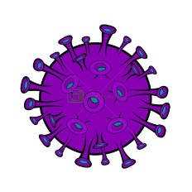
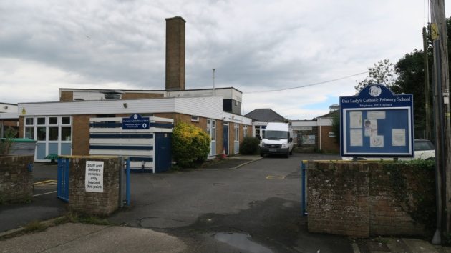


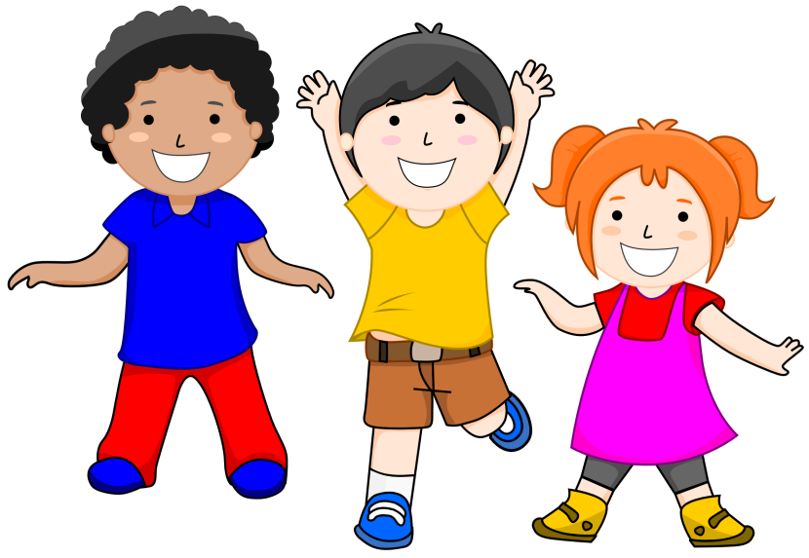
What will it be like, coming back to school after lockdown?

Slide 2


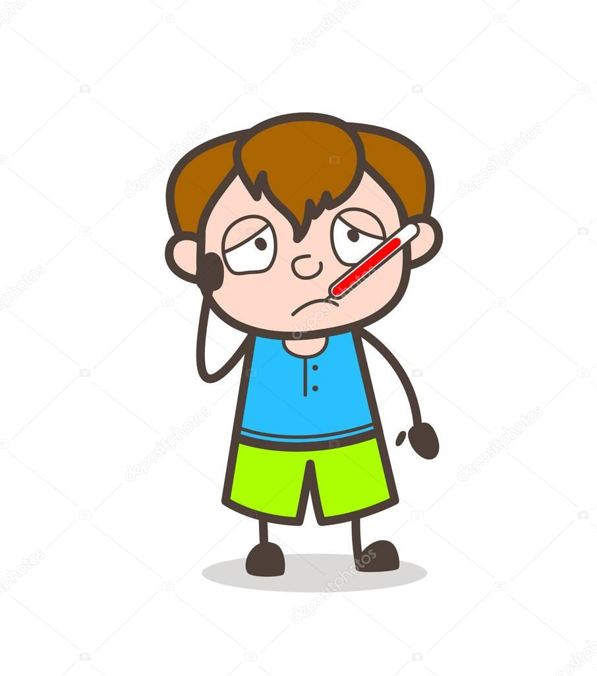

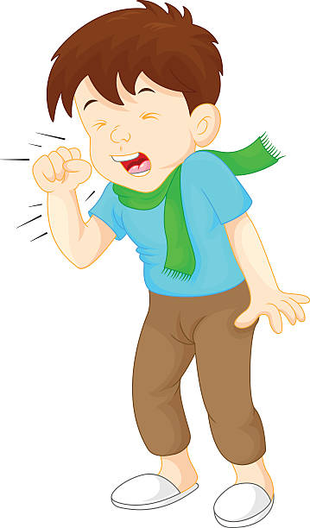
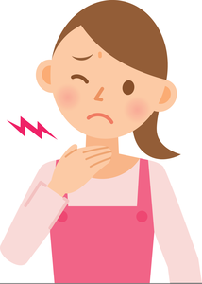
What is the Coronavirus?
Coronavirus cell
The Coronavirus is a virus like the common cold. They both make people feel unwell.
People who catch the Coronavirus may have:
a high temperature
a cough
a sore throat

Slide 3
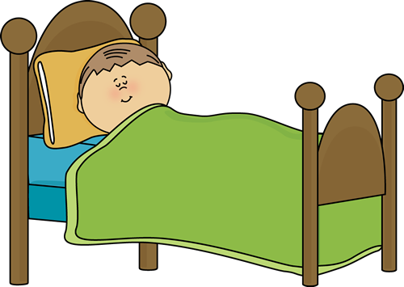
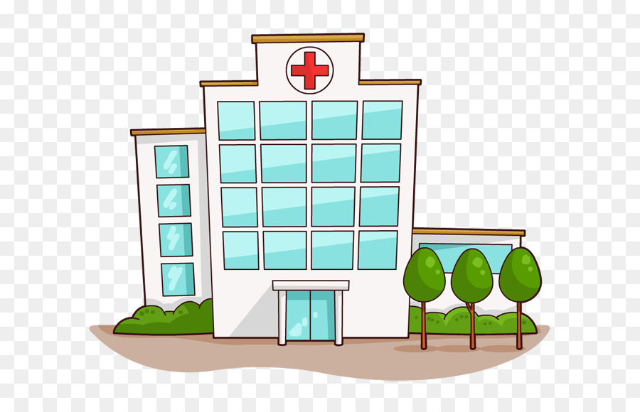
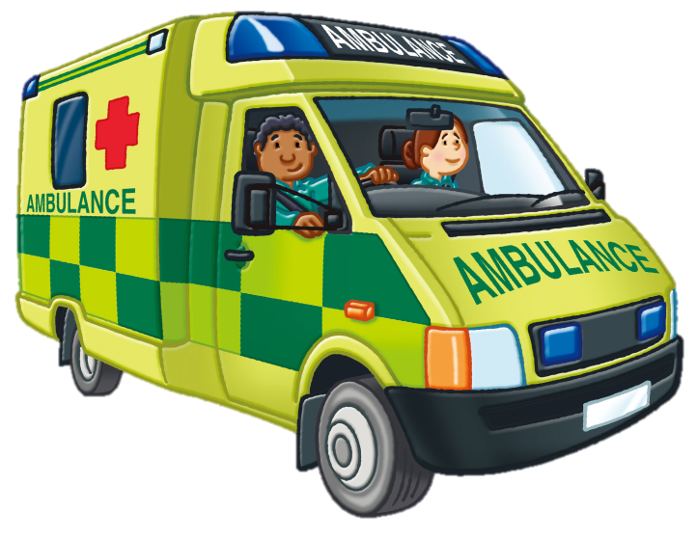
Most people who catch the Coronavirus will stay at home to get better.
Some people who catch the Coronavirus will go the hospital to get better.

Slide 4
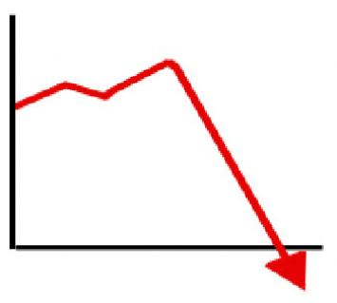

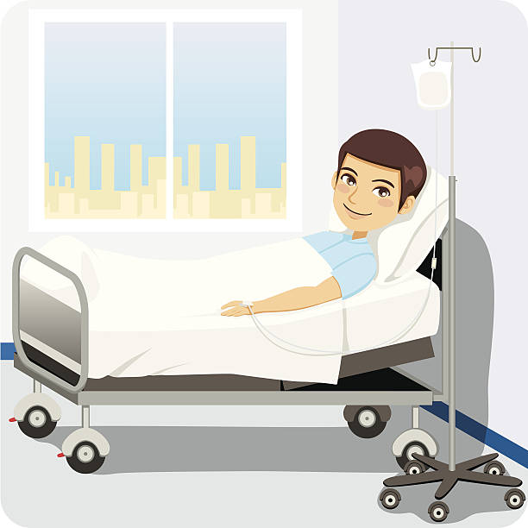

The spread of the Coronavirus has slowed.
The rate of infection
This means less people are catching the Coronavirus and getting unwell…
…and there are fewer people needing to go to hospital to get better.

Slide 5



Now that the spread of Coronavirus has slowed, it is safe for more children to return to school. To help keep us healthy, some children will still do their learning at home.
Some children will do their learning at home.
Some children will do their learning at school.

Slide 6

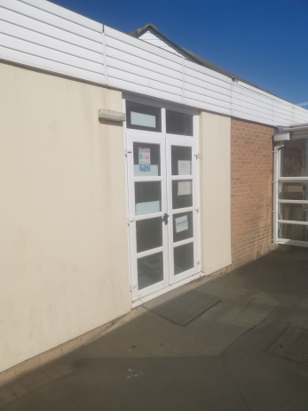
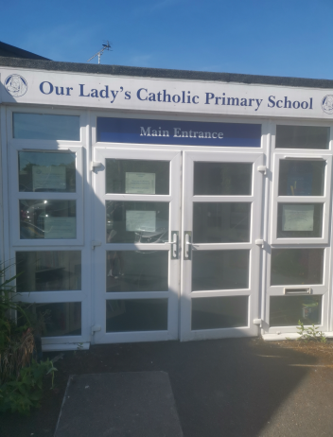
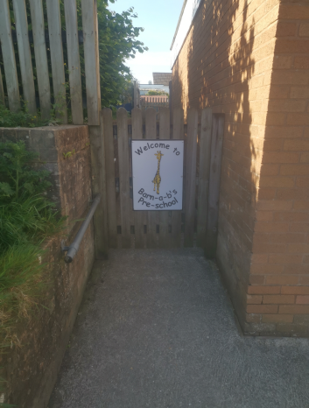
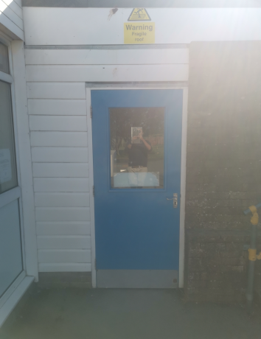
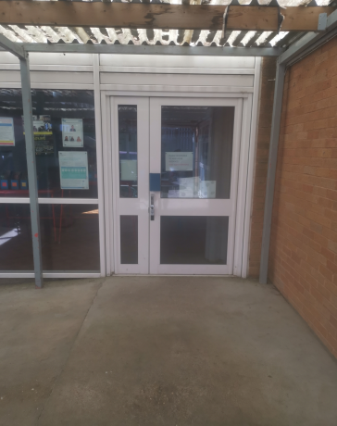
To help keep us safe, some of our daily school routines will be different.
Instead of your uniform, you will wear your home-clothes to school.
Everyone will arrive and leave school at different times and use different entrances.
Eagle class playground door
Main school
Entrance
Barn-a-b’s entrance
gate
Heron’s class
Playground door.
Dinner hall
Side entrance
Kestrels
Arrive: 8:50
Finish: 3:15
Barn-a-b’s
arrive: 8:30 am
Finish: 2:30 pm

Slide 7



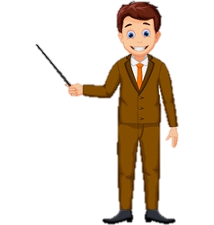
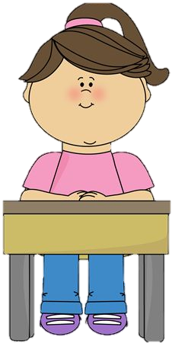
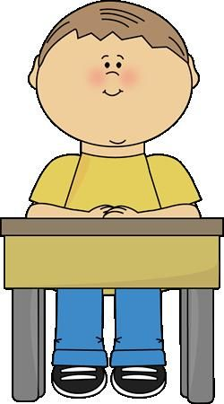



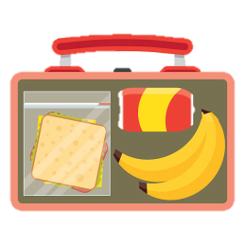
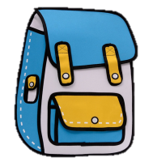
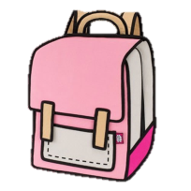
Some things in the classroom will be different too.
2. You may have a different teacher.
3. You will have your own table. You must sit at your desk unless you are asked to move.
1. Everyone must wash their hands before they come into class and regularly throughout the day.
4. Your books and other equipment will be on your table.
2 metres apart
6. You will eat lunch at your table.
5. You will put your school bag and lunch box under your table.
7. Not all your friends will be in class.

Slide 8
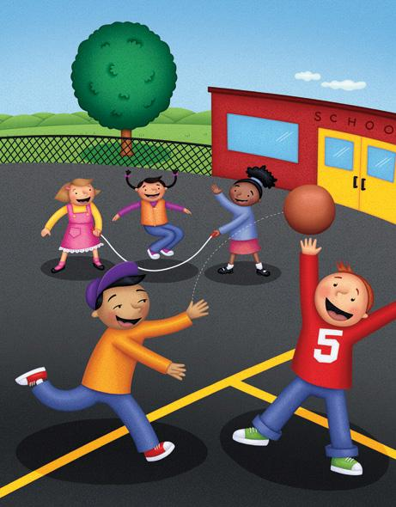
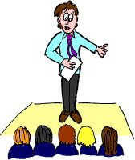
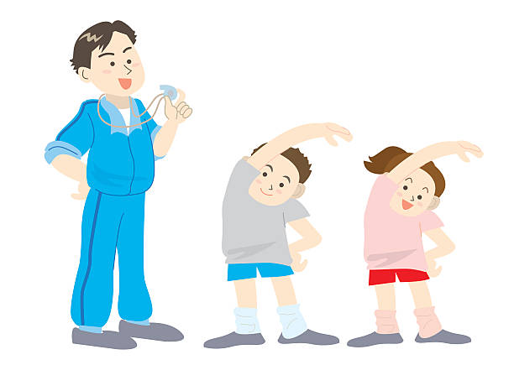


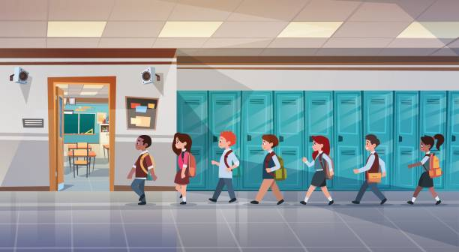
The school day, including playtimes, will also be different.
You will have P.E. with the children in your class.
You will only have break and lunch with the children in your class.
There will not be a daily assembly, but you can still pray to God everyday.
2m apart
When you walk around the school, you must keep to the left, in single file and stay 2 metres apart.

Slide 9
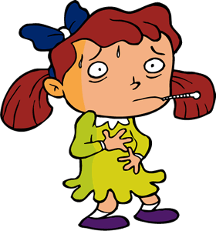
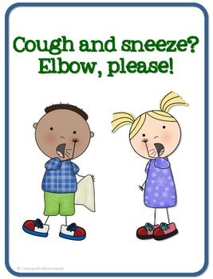
To help us all stay healthy and to stop the spread of germs we must…
… cough and sneeze into our elbow and then go and wash our hands…
… and if we become poorly we may have to go home and isolate.

Slide 10
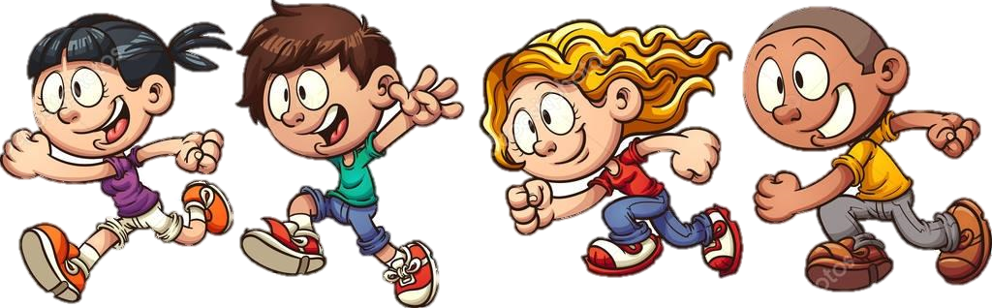

The Coronavirus has made daily life a little different. However school life, although strange at the moment will soon feel normal…
…and your friends and classmates will all soon return to school again.
I can’t wait to see my teachers!!
Hurray!! I’ve missed school!!
Remember: If you feel worried or have any questions talk to
an adult.

